Slide 1
Memory
Memory is an organism's mental ability to store, retain and recall information. (Wikipedia)
Memory is our ability to encode, store, retain and subsequently recall information and past experiences in the human brain.
It does this through three steps:
Encoding
Storage
Retrieval

Slide 2
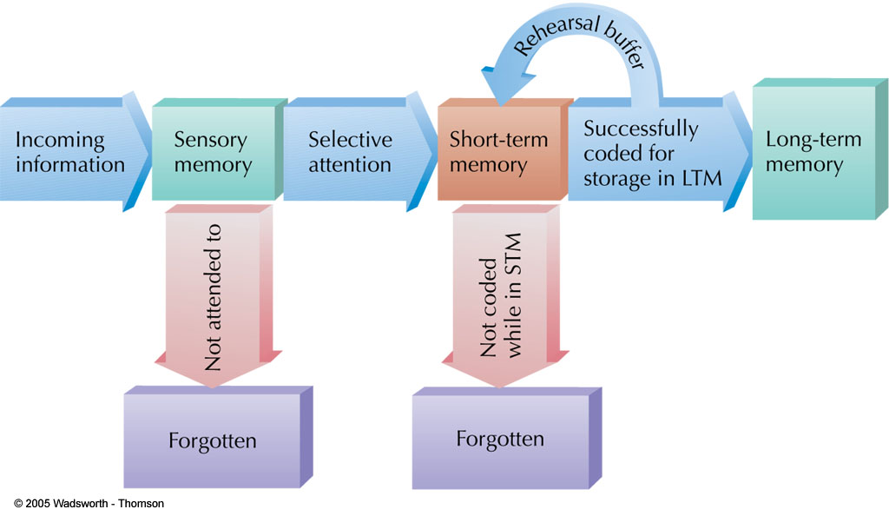
Remembering is thought to involve at least three steps. Incoming information is first held for a second or two by sensory memory. Information selected by attention is then transferred to temporary storage in short-term memory. If new information is not rapidly encoded, or rehearsed, it is forgotten. If it is transferred to long-term memory, it becomes relatively permanent, although retrieving it may be a problem. The preceding is a useful model of memory; it may not be literally true of what happens in the brain

Slide 3
Encoding
Encoding: the modification of information to fit the preferred format for the memory system.
When we are exposed to stimuli and encode information, we do it in three ways:
  Semantic Encoding
    encoding of meaning
    including meaning of words
  Acoustic Encoding
    encoding of sound
    especially sound of words
  Visual Encoding
    encoding of picture images

Slide 4
Storage
Storage: the retention of encoding material over time.
  In terms of storing material, we have three stages of memory
      Sensory Memory
      Working Memory (short-term memory)
      Long-term Memory

Slide 5
Retrieval
Retrieval: The locating and recovering of information from memory.
the calling back of stored information in response to some cue for use in a process or activity.
The third process is the retrieval of information that we have stored. We must locate it and return it to our consciousness. Some retrieval attempts may be effortless due to the type of information.

Slide 6
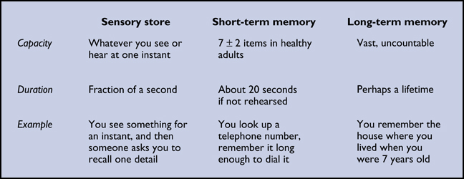
Types of Memory

Slide 7
Types of Memory
Sensory memory
Storing an exact copy of incoming information for a few seconds; the first stage of memory
  Icon: A fleeting mental image or visual representation
  Echo: After a sound is heard, a brief continuation of the sound in the auditory system
Sensory memories lasts just long enough to dissolve into the next one, giving us the impression of a constant flow.

Slide 8
Working memory/short term memory
Working memory is often known as short term memory. It is the place where we sort and encode information before transferring it to long-term memory, or forgetting it.
Generally, it holds information for about 20 seconds, far longer than sensory memory.
Most research suggest that we can hold seven pieces of information in our working memory, though it varies slightly.
We do have coping mechanisms, however:
    Chunking
    Rehearsal

Slide 9
Chunking
A chunk is any memory pattern or meaningful unit of memory.
By creating these chunks, a process called chunking, we can fit more information into the seven available slots of working memory.
  Example: 0303987123 vs. 0303-987-123

Slide 10
Rehearsal
Another memory technique is called maintenance rehearsal. This is a process where information is repeated to keep it from fading while in working memory.

Slide 11
Long term memory
Storing information relatively permanently
Stored on basis of meaning and importance
As far as anyone knows, there is no limit to the duration or capacity of the long term memory.
Long term memory is essentially all of your knowledge of yourself and the world around you. Unless an injury or illness occurs, this memory is limitless.

Slide 12
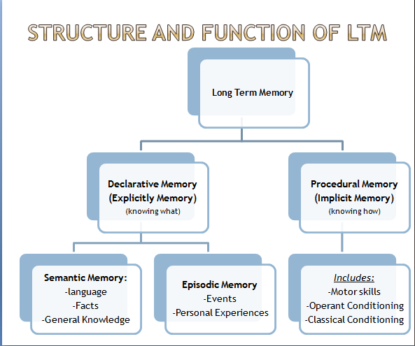

Slide 13
Long Term memory
Procedural memory (implicit) is the part of long term memory where we store memories of how things are done. (knowing how)
Declarative memory (explicit) is the part of long term memory where we store specific information such as facts and events. (knowing what)
    More often than procedural memory, declarative memory requires some conscious mental effort.

Slide 14
Declarative memory
Declarative memory has two divisions:
  Episodic Memory: This is the portion of memory that stores personal events or “episodes.”
    This is the storage of things like time and place.
  Semantic Memory: This portion of memory stores general knowledge, facts and language meaning.
    This is specifically where all the information you “know” is stored.

Slide 15
Forgetting
Forgetting refers to loss of information from long-term memory.
Encoding Failure: When a memory was never formed in the first place
Memory Traces: Physical changes in nerve cells or brain activity that occur when memories are stored
Memory Decay: When memory traces become weaker; fading or weakening of memories; happens frequently for sensory memories and short-term memories
Disuse: Theory that long-term memory traces weaken when memories are not used or retrieved often

Slide 16
More on Forgetting
Repression: Unconsciously pushing painful, embarrassing or threatening memories out of awareness/consciousness
  Motivated forgetting, according to some theories
Suppression: Consciously putting something painful or threatening out of mind or trying to keep it from entering awareness

Slide 17
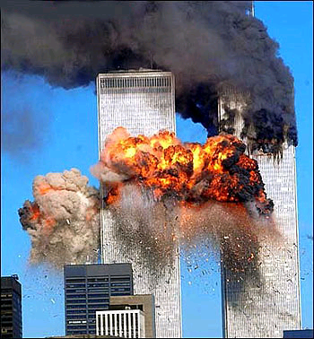
Flashbulb Memories
Of all our forms of memory, a few are exceptionally clear and vivid. We call these flashbulb memories.
  These tend to be memories of highly emotional events. Typically people remember exactly where they were when the event happened, what they were doing and the emotions they felt.
      Ex. 9/11
Includes both positive and negative events

Slide 18
Ways to Improve Memory
Knowledge of Results: Feedback allowing you to check your progress
Recitation: Summarizing aloud while you are rehearsing material
Rehearsal: Reviewing information mentally (silently)
Selection: Selecting most important concepts to memorize
Organization: Organizing difficult items into chunks; a type of reordering

Slide 19
Ways to Improve Memory
Whole Learning: Studying an entire package of information at once, like a poem
Part Learning: Studying subparts of a larger body of information (like text chapters).
Spaced Practice: Alternating study sessions with brief rest periods
Serial Position Effect: Making most errors while remembering the middle of the list.

Slide 20
Memory effects by
Massed Practice: Studying for long periods without rest periods
Lack of sleep decreases retention; sleep aids consolidation
Hunger decreases retention

